Slide 1
ERASMUS PLUS PROGRAM Information meeting
22.12.2022 r., Olsztyn

Slide 2
contributing to the establishment of a global European Education Area and strengthening the links between education and research
supporting employability, social inclusion, active citizenship, innovation and environmental sustainability in Europe and beyond
What Eramus programme is?
Higher education sector
Adult education sector
Youth education sector
School education sector

Slide 3
The Erasmus Plus program has been operating in Poland for 30 years.
The allocation at the EU level for 2021-2027 is EUR 3.393 billion.

Slide 4
Education, Audiovisual and Culture Executive Agency in Brussels (EACEA)
NATIONAL AGENCIES IN EVERY EU COUNTRY (Warszawa, Foundation for the Development of the Education System)
ERASMUS PLUS PROGRAM STRUCTURE

Slide 5
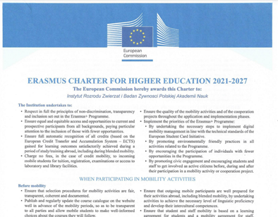
Since November 2022, the Institute has had the ECHE Erasmus Plus card for higher education institutions, which enables participation in grant competitions in the Erasmus Plus program.

Slide 6
Erasmus Plus for Higher Education
Key Action 1 - Learning mobility of individuals
Mobility of employees in the higher education sector:
- a teaching or training period abroad at a partner HEI
- lump sums (stay: accommodation and sustenance, travel, organizational costs)
Key Action 2 – Cooperation between organizations and institutions
Cooperation partnerships and capacity building of organizations at the transnational level:
- A teaching or training period home in Poland by a partner HEI (universities, research institutions, HEI sector in general)
Partnerships min. 3 HEI sector institutions
Lump sum projects for the amount of PLN 120,000 EUR, 250 thousand EUR and 400 thousand. EUR
- lump sums (accommodation and sustenance, travel)

Slide 7
Horizontal priorities E+
INCLUSION AND DIVERSITY
promoting equal opportunities and equal access, social inclusion, diversity and fairness in all its activities
Disability: includes reduced physical, mental, intellectual or sensory abilities
Health issues: barriers can be due to health issues such as serious illnesses, chronic illnesses or any other physical or mental health situation
Economic barriers: economic disadvantages such as low standard of living, low income, being a learner who has to work can be a barrier

Slide 8
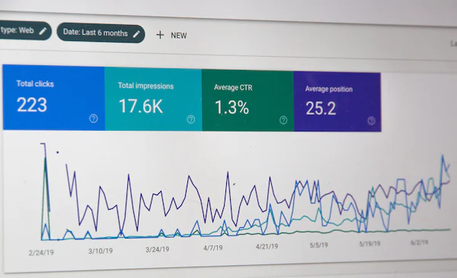
Horizontal priorities E+
DIGITAL TRANSFORMATION
a) developing a highly effective digital education ecosystem, by building the capacity and necessary knowledge in all types of education and training institutions to exploit the opportunities offered by digital technologies for teaching and learning purposes
(b) improving digital skills and developing skills at all levels of society and for all (including young people with fewer opportunities, students, jobseekers and workers). Particular attention will be given to fostering the development of both basic and advanced digital skills as well as digital skills

Slide 9
Horizontal priorities E+
THE ENVIRONMENT AND FIGHTING CLIMATE CHANGE
providing learners of all ages with opportunities to learn about the climate crisis and sustainable development
the need to prioritize learning for the green transition in education and training policies and programmes.

Slide 10
Horizontal priorities E+
PARTICIPATION IN DEMOCRATIC LIFE, COMMON VALUES AND CITIZENSHIP
a) encouraging active citizenship and ethical behavior as part of lifelong learning and education, enhancing the development of social and intercultural competences, critical thinking and media literacy
b) priority is given to projects enabling democratic participation and social and civic engagement through formal and informal learning activities

Slide 11
ECHE card for the Institute
HEI KA131 - International mobility including countries associated with the Program (Norway, Iceland, Liechtenstein), the partner has an ECHE card
Deadline: February 23, 2023, at 12:00
Project duration: 26 months
HEI KA171 - International mobility involving third countries not associated with the Programme
Deadline: February 23, 2023, at 12:00
Project duration: 24 or 36 months

Slide 12
ECHE card for the Institute
International mobility
a) short-term or long-term physical study or traineeship mobility periods abroad: the whole is financed by the sending institution (except for the KA171 competition), the incoming person must buy an accident assurance policy and civil liability insurance (destruction of property, e.g. laboratory)
International mobility
b) short-term or long-term physical study or traineeship mobility periods abroad: the whole is financed by the sending institution (except for the KA171 competition), the person leaving must buy an accident and civil liability insurance (destruction of property, e.g. a laboratory)

Slide 13
TARGET GROUPS IN ERASMUS PLUS HEI SECTOR
1) Student mobility
2) Mobility of doctoral students
In order to better meet the diverse education and training needs of doctoral candidates and to ensure a level playing field with those with higher education staff status, doctoral candidates and recent doctoral graduates may undertake short- or long-term mobility related to physical studies or practices abroad.
3) Staff mobility
Staff mobility can be carried out by any type of higher education staff or invited staff from outside the higher education institution. To ensure high-quality mobility activities with maximum impact, the mobility activity must be related to the professional development of the employee and to his/her learning and personal development needs.

Slide 14
PARTNERSHIPS IN THE ERASMUS PLUS PROGRAM
A mobility project must involve at least two organizations from different Program Countries (at least one sending and at least one host organisation). For mobility projects supported by external policy funds (KA171), at least one organization from a third country not associated to the Program must be involved.
Sending organisation - a participating organisation sending one or more participants to an activity of an Erasmus+ project
Receiving organisation - a participating organisation receiving participants and organising activities of an Erasmus+ project

Slide 15
DESCRIPTION OF ERASMUS PLUS ACTIONS

Slide 16
Mobility in the ERASMUS PLUS program
KA 131 - EU countries and associated countries (e.g. Norway, Iceland)
KA171 - non-associated countries, "whole world" excluding e.g. UK, Switzerland

Slide 17
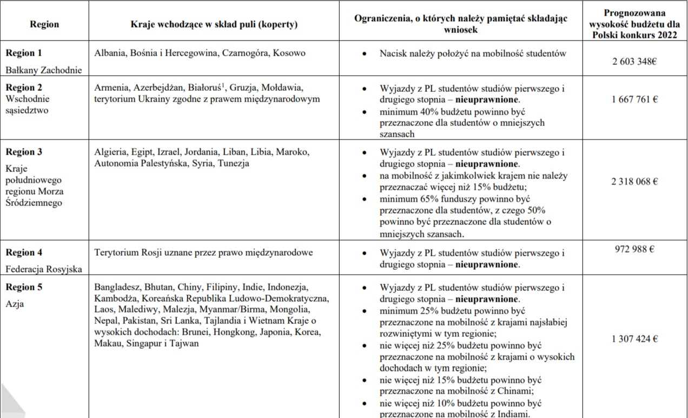
REGIONS IN THE CALL KA171

Slide 18
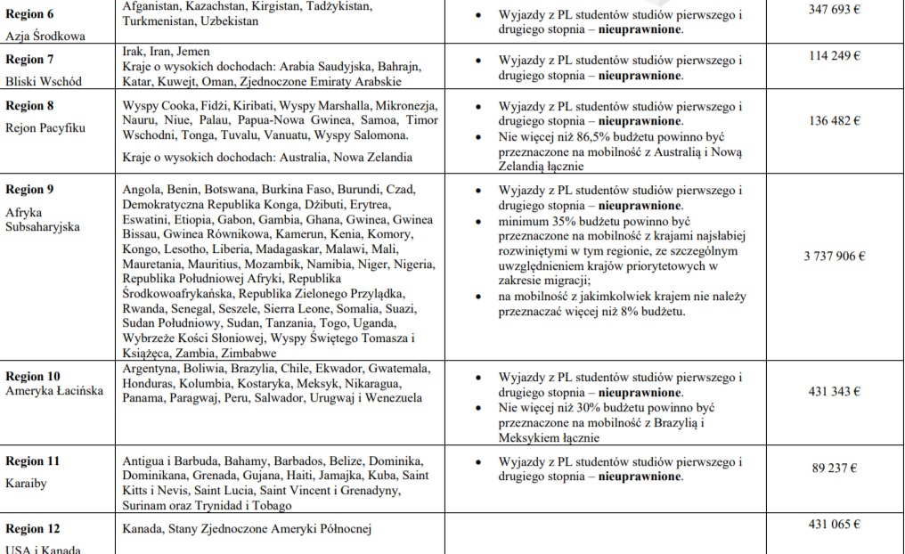
REGIONS IN THE CALL KA171

Slide 19
MOBILITY OF PHD STUDENTS - KA131
Mobility for study or internship for PhD students:
- short-term mobilities from 5 to 30 days
- long-term mobilities from 2 months (or one academic semester or trimester) to 12 months of physical mobility, excluding travel time
- from 2 days to 2 months of physical mobility in the case of mobility for traineeships
- obligatory at least 3 ECTS credits to be obtained in the framework of mixed mobility
- during third-cycle studies as a doctoral student (doctoral level or level 8 of the EQF - European Qualifications Framework).

Slide 20
MOBILITY OF PHD STUDENTS - KA131
Mobility for study or internship for PhD students:
Each period of study or professional practice abroad, of any length, also as part of doctoral student mobility, can be implemented in the form of mixed mobility. (combination of physical and virtual mobility facilitating teamwork and exchange of experiences based on collaborative e-learning. For example, the virtual component could create a common online space for learners).

Slide 21
MOBILITY OF PHD STUDENTS - KA131
Blended mobility
Blended mobility is a combination of physical and virtual mobility facilitating teamwork and exchange of experiences based on cooperative e-learning
Participation in short-term physical mobility by combining it with a mandatory virtual component
Students (short cycle/bachelor/master) who are not able to participate in long-term physical study or traineeship mobility, for example, due to their study field or because they have fewer opportunities for participation, will be able to carry out a short-term physical mobility by combining it with a compulsory virtual component.

Slide 22
STAFF MOBILITY FOR TEACHING AND TRAINING PURPOSES:
1) The duration of mobility between EU Member States and countries associated to the Program must be between 2 days and 60 days of physical mobility, excluding travel time. For invited employees of enterprises, the minimum duration of physical mobility is 1 day
2) For mobility from third countries not associated to the Programme, the duration must be between 5 and 60 days, excluding travel time. The same applies to invited employees of enterprises, excluding travel time.

Slide 23
STAFF MOBILITY
Teaching staff mobility can take place in any academic discipline
Participation in training abroad that is relevant to their daily work in a higher education institution. This may take the form of training (excluding conferences) or periods of job observation and teaching activities.
The didactic activity must include at least 8 hours a week, if combined with training, min. it's 4 hours

Slide 24
COSTS IN THE ERASMUS PLUS PROGRAM
Financing mobility by the Sending Institution
Lump sum costs: travel, accommodation and sustenance, organizational support, organization of mobility activities for people with fewer opportunities (people with disabilities), exceptional costs

Slide 25
COSTS IN THE ERASMUS PLUS PROGRAM - DOCTORAL STUDENTS
1) Short-term mobilities
2) Long-term mobilities - PhD students from the EU to non-associated countries, regions 1-12: EUR 700
3) Mobilities of doctoral students from third countries not associated with the Program from regions 1-12 to EU Member States: from EUR 800 to 900
The duration of the physical activity | Amount (for all EU Member States and third countries associated to the Program or third countries not associated to the Programme)
up to the 14th day | 79 EUR per day
from the 15th to the 30th day | 56 EUR per day

Slide 26
ERASMUS PLUS COST – SCIENTIFIC STAFF
Host country | Employees from EU Member States and third countries associated with the Programme | Employees from third countries not associated with the Programme
 | Amount min.–max (per day) | Daily amount
Dania, Finlandia, Islandia, Irlandia, Liechtenstein, Luksemburg, Norwegia i Szwecja | 90–180 EUR | 180 EUR
Państwa trzecie niestowarzyszone z Programem z regionu 14 | 90–180 EUR | NOT ELIGIBLE
Austria, Belgia, Cypr, Francja, Niemcy, Grecja, Włochy, Malta, Niderlandy, Portugalia i Hiszpania. | 79–160 EUR | 160 EUR
Państwa trzecie niestowarzyszone z Programem z regionu 13 | 79–160 EUR | NOT ELIGIBLE
Bułgaria, Chorwacja, Czechy, Estonia, Węgry, Łotwa, Litwa, Macedonia Północna, Polska, Rumunia, Serbia, Słowacja, Słowenia, Turcja | 67–140 EUR | 140 EUR
Państwa trzecie niestowarzyszone z Programem z regionów 1– 12 | 180 EUR | NOT ELIGIBLE

Slide 27
ERASMUS PLUS COST – SCIENTIFIC STAFF
Host country | Employees from EU Member States and third countries associated with the Programme | Employees from third countries not associated with the Programme
 | Amount min.–max (per day) | Daily amount
Dania, Finlandia, Islandia, Irlandia, Liechtenstein, Luksemburg, Norwegia i Szwecja | 90–180 EUR | 180 EUR
Państwa trzecie niestowarzyszone z Programem z regionu 14 | 90–180 EUR | NOT ELIGIBLE
Austria, Belgia, Cypr, Francja, Niemcy, Grecja, Włochy, Malta, Niderlandy, Portugalia i Hiszpania. | 79–160 EUR | 160 EUR
Państwa trzecie niestowarzyszone z Programem z regionu 13 | 79–160 EUR | NOT ELIGIBLE
Bułgaria, Chorwacja, Czechy, Estonia, Węgry, Łotwa, Litwa, Macedonia Północna, Polska, Rumunia, Serbia, Słowacja, Słowenia, Turcja | 67–140 EUR | 140 EUR
Państwa trzecie niestowarzyszone z Programem z regionów 1– 12 | 180 EUR | NOT ELIGIBLE

Slide 28
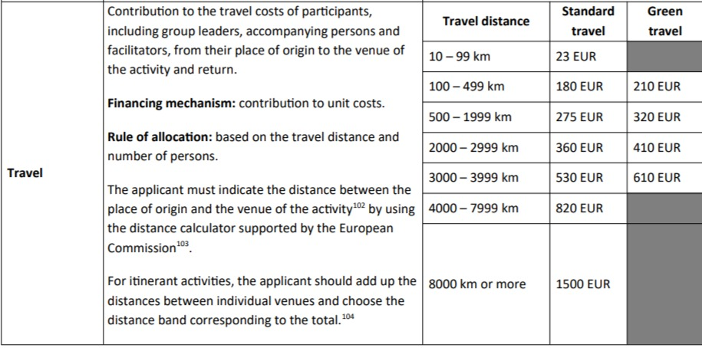
TRAVEL COSTS IN ERASMUS PLUS PROGRAMME

Slide 29
APPLICATION IN COMPETITION KA171
Registration in the system and assignment of an OID number to a foreign organization
Description of previous experience in cooperation with institutions in those third countries that are not associated with the Programme.
How this project will contribute to new cooperation in the field of education and/or research in the region - future cooperation.
Number and length of individual mobilities (departures and arrivals), to which Institutions and countries, what type of mobility
A HEI sending students and staff as mixed intensive learners must be an HEI from an EU Member State or a third country associated to the Program with an ECHE or a HEI from a third country not associated to the Program recognized by the competent authorities that signed inter-institutional agreements with partners from an EU Member State or a third country associated with the Program before starting the mobility.

Slide 30
THANK YOU!

